Slide 1

INDUSTRIAL TRAINING REPORT
TOPIC:ANALYSIS OF CRIME REPORTS IN INDIA USING BIG DATA

Slide 2




GROUP MEMBERS
01
02
AKASH SINGH
(201600022)
AKASH GUPTA
(201600037)
03
04
BISHAL CHETTRI
(201600030)
NUTAN THAPA
(201600208)

Slide 3


tJ
INTRODUCTION
India being one of the most populated countries in the world is a hub for a large number of crimes committed. Crimes in India exists in various forms and has been tracked by time and location. Most of these crimes have the female section of our society in the receiving end there by making India an unsafe place for the women.
In the project we try to analyse the crimes related data using tools like Impala, Hive, Cloudera, Tableau etc. So that we can infer important information that can be used to take proper actions in order to reduce the frequency of such unfortunate events.

Slide 4


tJ
OBJECTIVE
Exploiting the use of tools like Hive, Impala , Tableau, Cloudera etc. so that we can properly extract information from a large piece of data.
Getting used to table formats, creation of tables, executing queries so that we can understand what type of data can be inferred from a chunk of data.
Handling of Big Data effectively and efficiently.

Slide 5





SOFTWARE USED
2
2
1
2
3
4
4
5

Slide 6



DATASET
The Dataset for our project was downloaded from Kaggle.
The Dataset consists of three tables:
1.Victims of Rape in India(.csv file)
2.Complaints against police in India(.csv file)
3.Arrests under crime against women in India(.csv file)

Slide 7


tJ
PROBLEM STATEMENT
Our main aim was to find those states in which the maximum number of crimes were committed against women so that using this data necessary actions could be taken by the respective governments, also using the dataset we could see trend in increase or decrease of such crimes across India.
Also the data can be used to analysed whether the cases filed were valid or just vague.
Such analysis helps the respective authorities to take necessary actions against such crimes and help in building a safe society for the women in India.

Slide 8
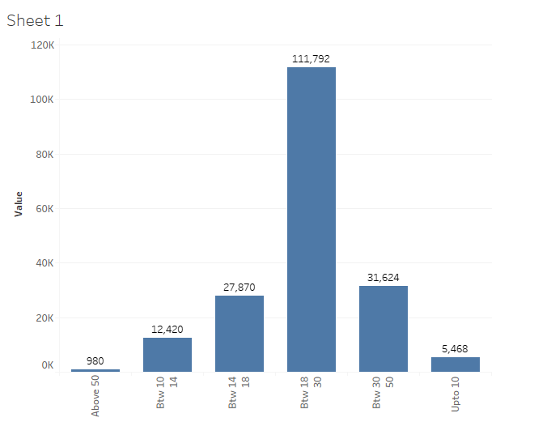
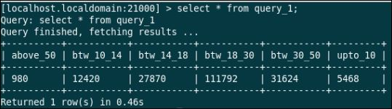
tJ
QUERY NO:1
Age Group mostly affected by rape.

Slide 9
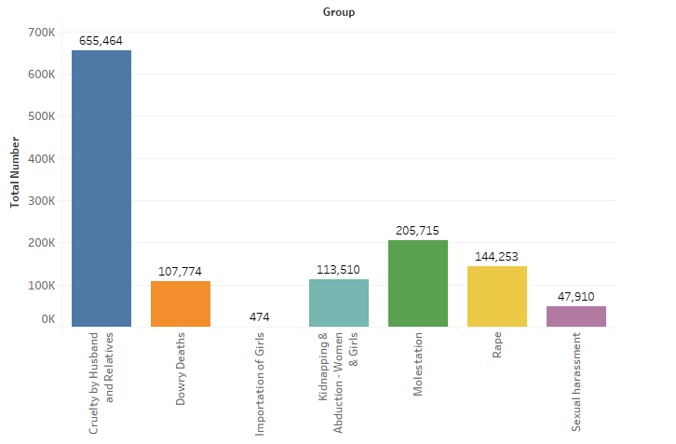
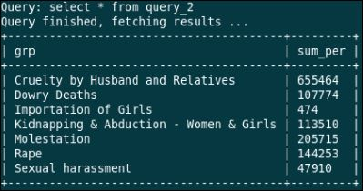
tJ
QUERY NO:2
Most Crimes committed against women category.

Slide 10
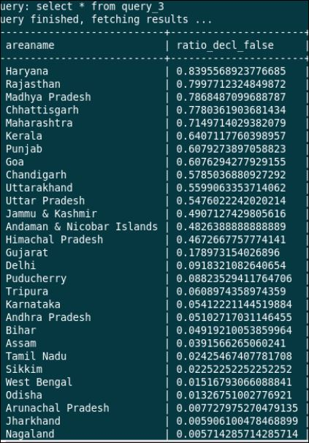
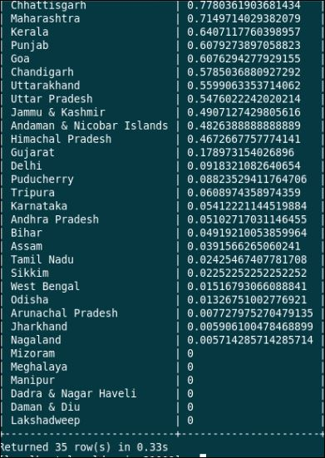
tJ
QUERY NO:3
No. of actions took based on complaints filed : (ratio declared false)

Slide 11
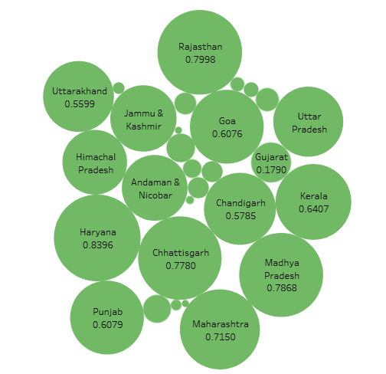

Slide 12
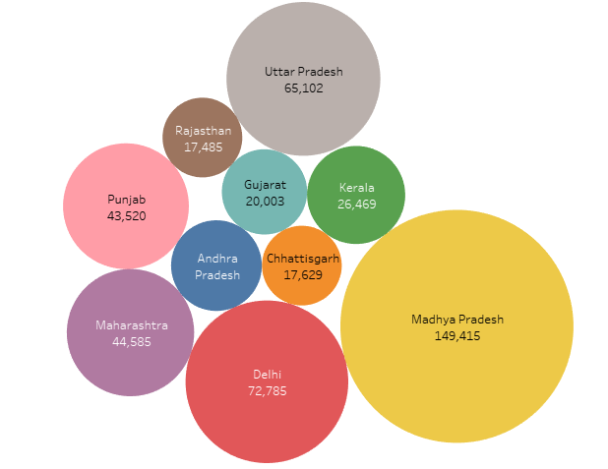
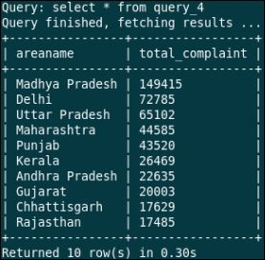
tJ
QUERY NO:4
In which state is the most no of complaint filed against police.

Slide 13
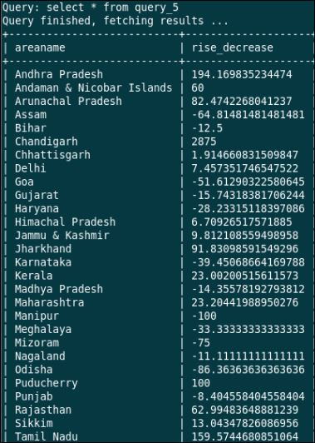
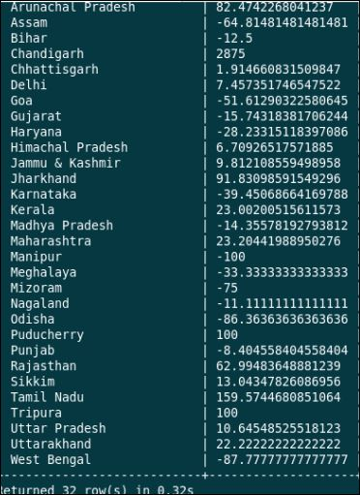
tJ
QUERY NO:5
Percentage rise or decrease in no. of police complaint in last two years

Slide 14
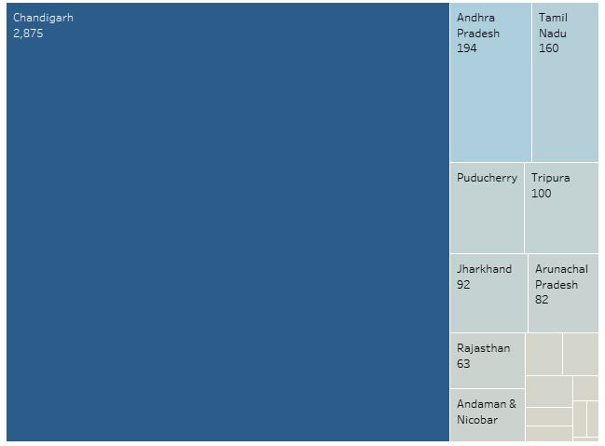

Slide 15
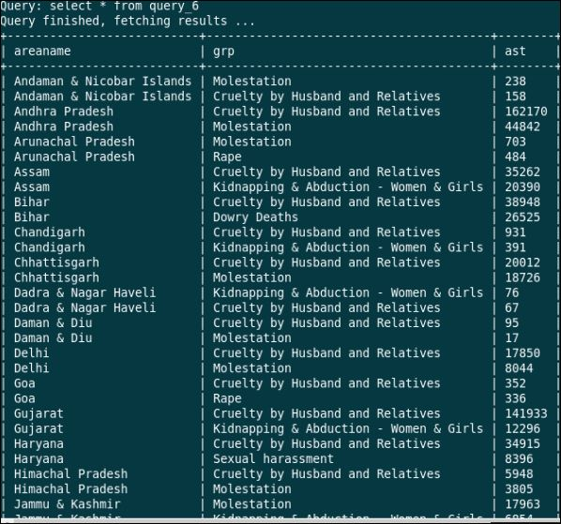
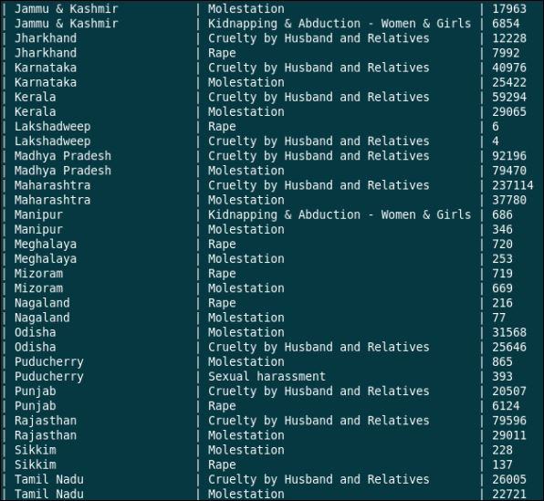
tJ
QUERY NO:6
Top 2 crimes of each state against women.

Slide 16
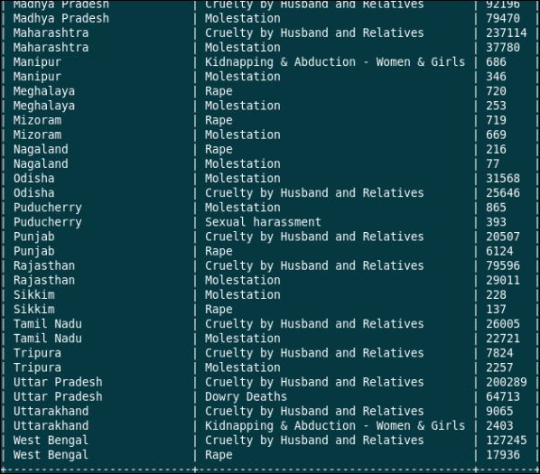

Slide 17
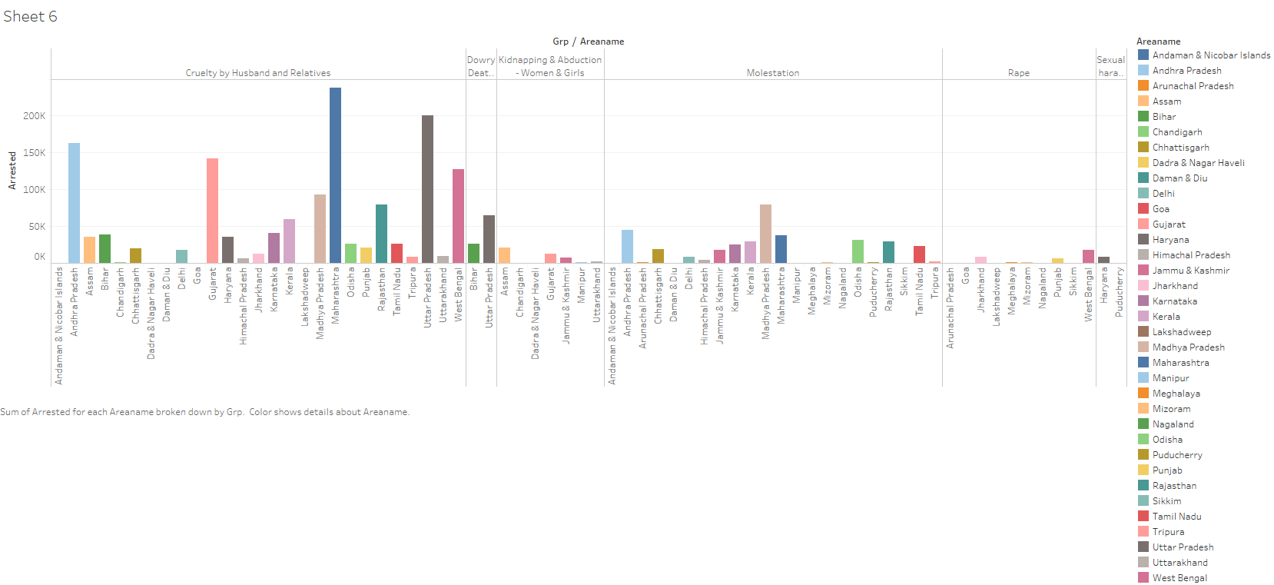

Slide 18
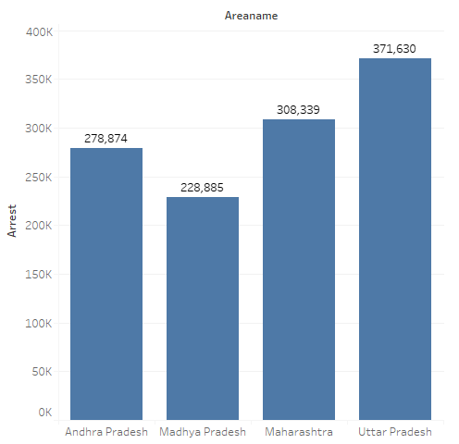
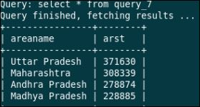
tJ
QUERY NO:7
State with highest no of crime against women.

Slide 19
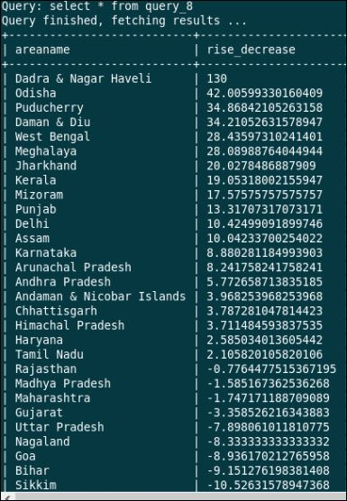
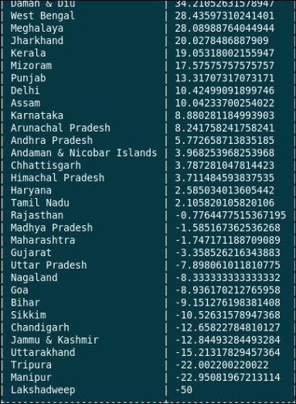
tJ
QUERY NO:8
Increase or decrease in the total crime against women in last two years.

Slide 20
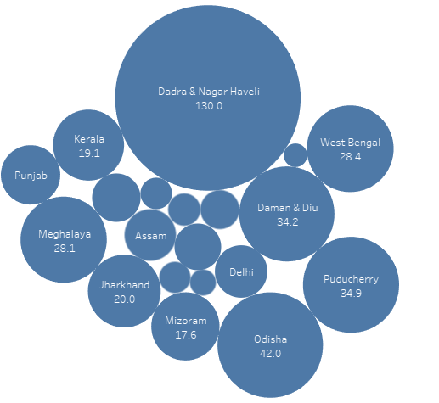

Slide 21
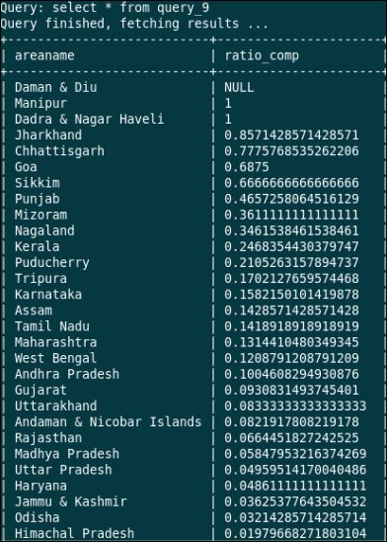
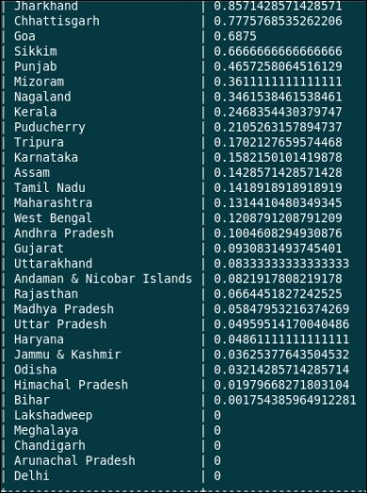
tJ
QUERY NO:9
Ratio of police personnel sent for trial and the trial completed in 10 years

Slide 22
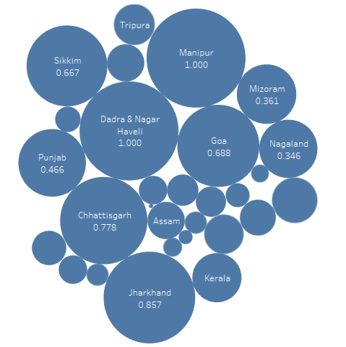

Slide 23
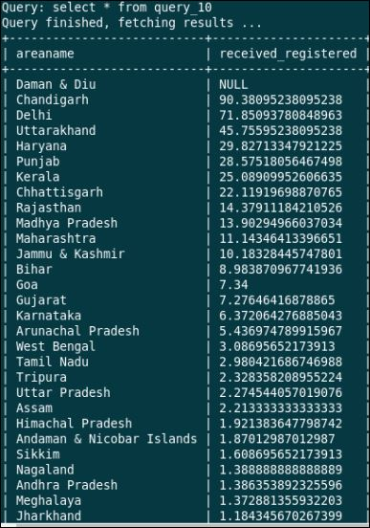
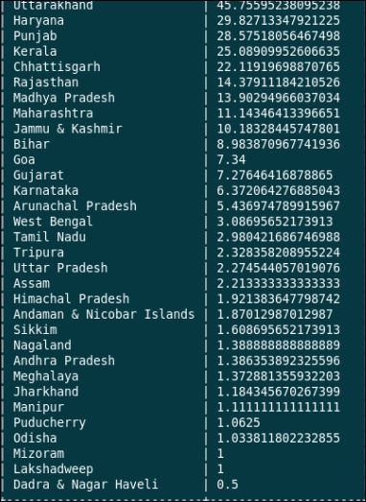
QUERY NO:10
tJ
No. of complaints registered / No. of cases recieved.

Slide 24
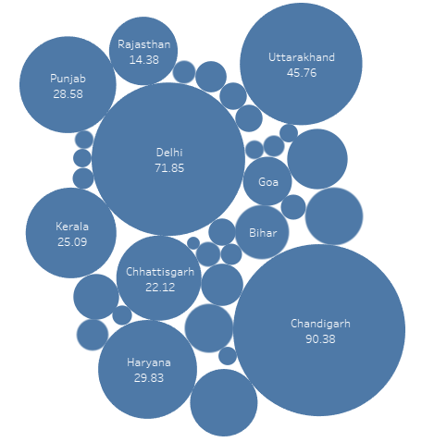

Slide 25
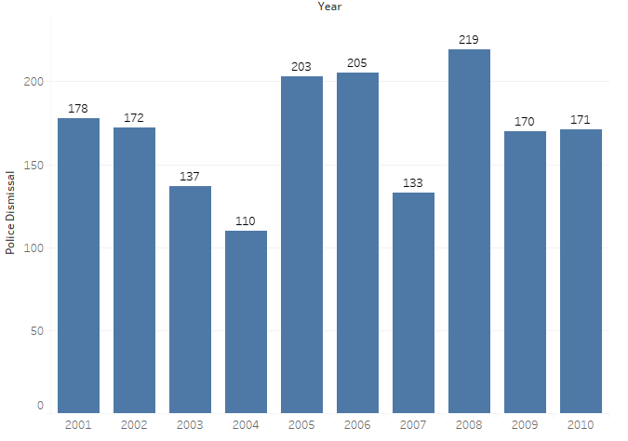
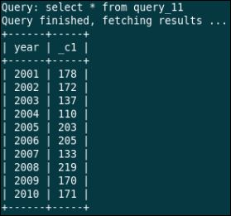
tJ
QUERY NO:11
Highest no of police personnel dismissal year wise.

Slide 26
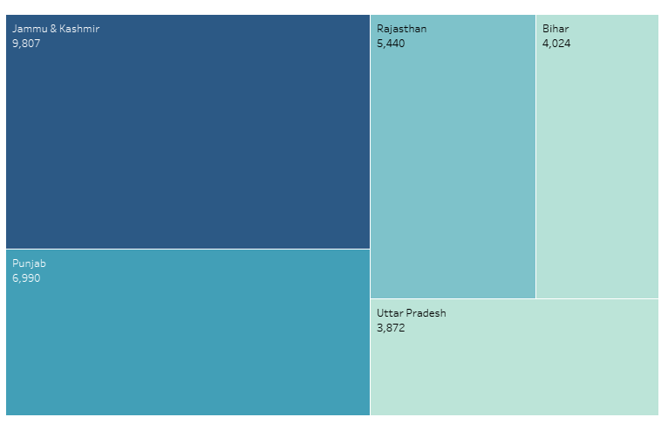
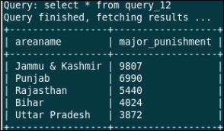
tJ
QUERY NO:12
Top 5 states with most no. of major punishments for police in the decade(2001-2010)

Slide 27
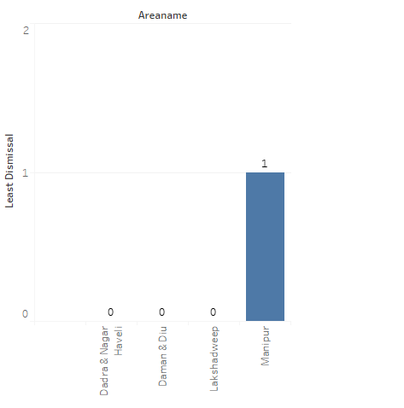
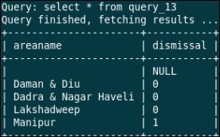
tJ
QUERY NO:13
State with least no of dismissal

Slide 28
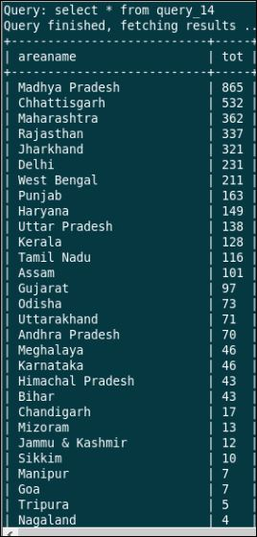
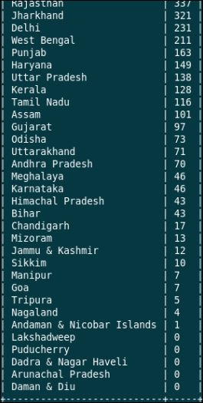
tJ
QUERY NO:14
Total no of incest rape in each state during 2001-2010

Slide 29
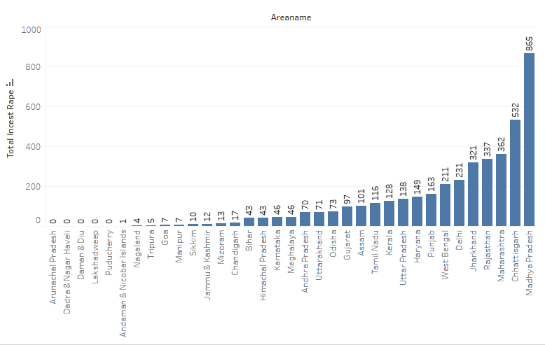

Slide 30
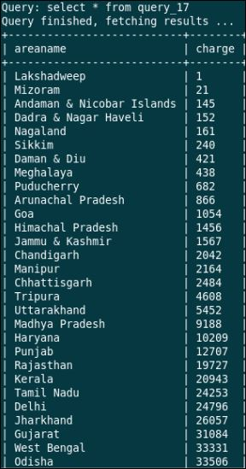
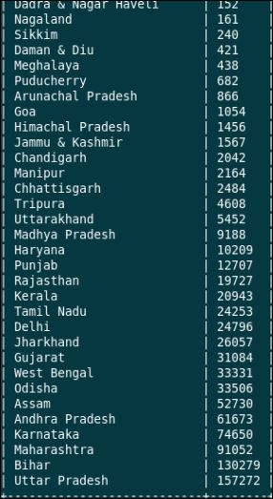
tJ
QUERY NO:15
State wise count of people released by police or magistrate due to lack of evidence year wise.

Slide 31
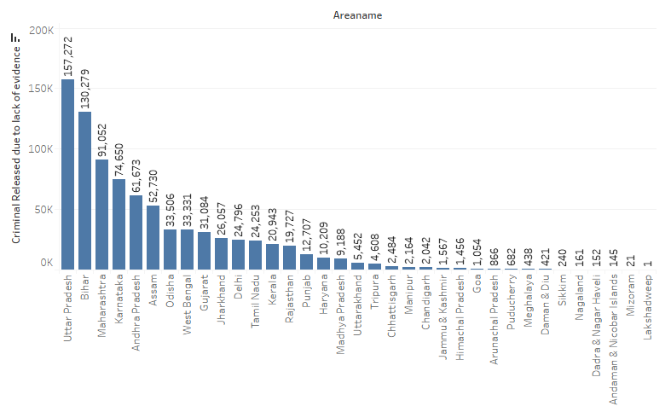

Slide 32
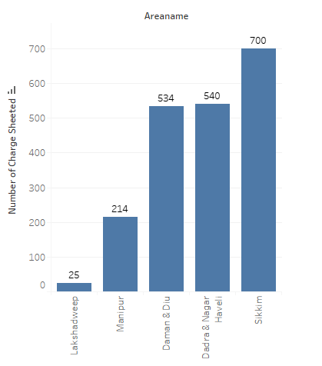
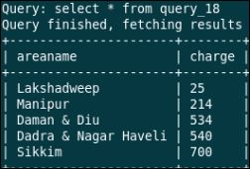
tJ
QUERY NO:16
States that can be considered safe for women.

Slide 33
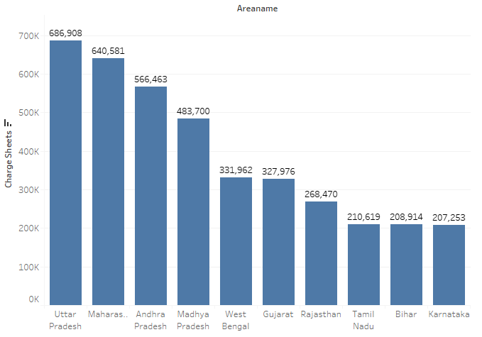
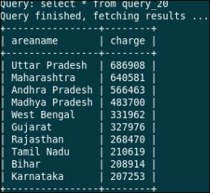
tJ
QUERY NO:17
State with highest crime against women

Slide 34
FUTURE SCOPE OF PROJECT
This analysis was done on data collected between 2001-2010,hence the queries ran over this data could be reused on a fresh set of data to infer new information on the same topic.
The back end of this project could be modified in order to analyse a new dataset.
Tools such as Tableau, Hive, Impala etc. could be used in future that will provide a wide range of features which can help interpret huge volumes of data.

